Slide 1

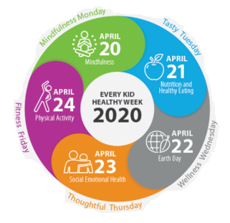
Every Kid Healthy Week
20th April- 24th April
Notes:
Every Kid Healthy Week

Slide 2
Overview
Mindfulness Monday | Meditation Session | 5 Mindfulness Activities | Pinwheel Activity
Tasty Tuesday | Healthy plate | Rainbow Activity | Ready, Steady, Cook!
Wellness Wednesday | Design a board game | Earth Pledge | 10 ways to help the Earth
Thoughtful Thursday | Thoughtful Letter | Kindness Bingo | Love Lanterns
Fitness Friday | Just Dance | Go for a walk | Create own routine
Notes:
Overview of activities

Slide 3

Mindfulness Monday
20th April
Activity Ideas:
Meditation Session.
5 Fun Mindfulness Activities.
Pinwheel Activity.
Notes:
Mindfulness Monday- 20th April

Slide 4

Meditation Session
Notes:
Video link: https://www.youtube.com/watch?v=Bk_qU7l-fcU

Slide 5
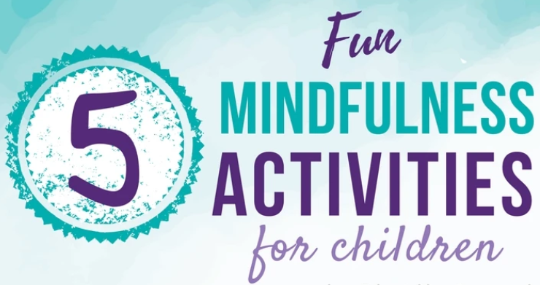
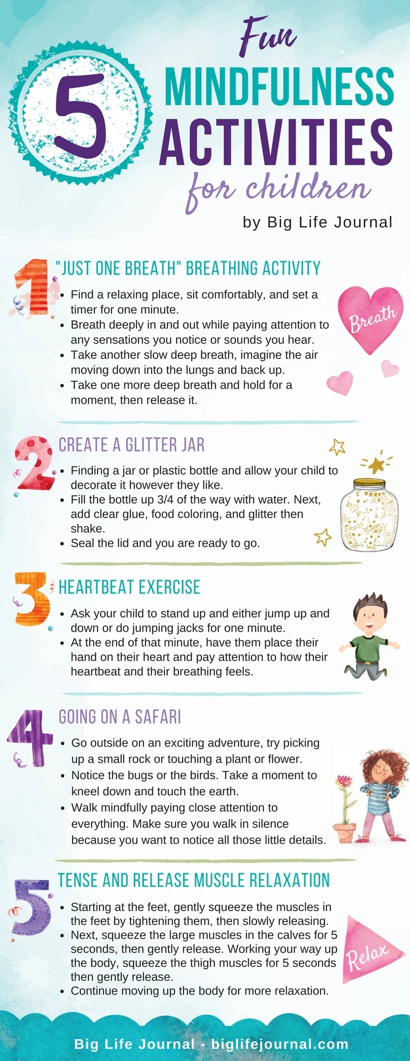
Notes:
5 fun mindfulness activities

Slide 6
Notes:
5 fun mindfulness activities

Slide 7
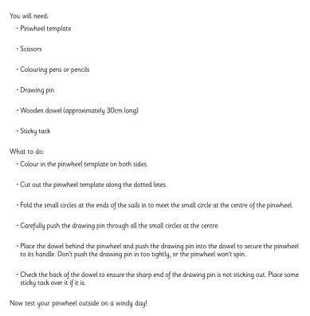

Pinwheel Activity
Providing children with an object to focus on is a great way to encourage concentration during mindfulness sessions. Use pinwheels in conjunction with the mindful breathing exercise above, making the pinwheel spin with every exhale.
Notes:
Pinwheel activity with instructions

Slide 8
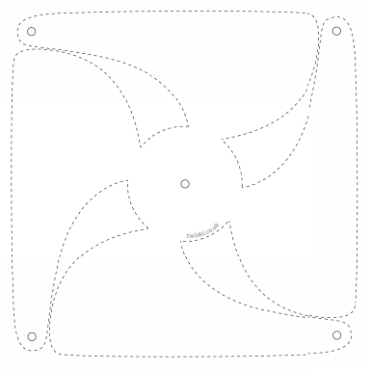
Notes:
Template for pinwheel

Slide 9
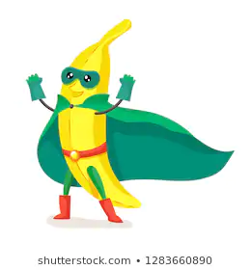
Tasty Tuesday
21st April
Activity Ideas:
Design your own healthy plate.
Rainbow fruit activity.
Ready, steady, cook! Each year group to complete 1 of 2 recipes. (or both!) Take photos or film your own vlog whilst making your meal.
Notes:
Tasty Tuesday- 21st April

Slide 10
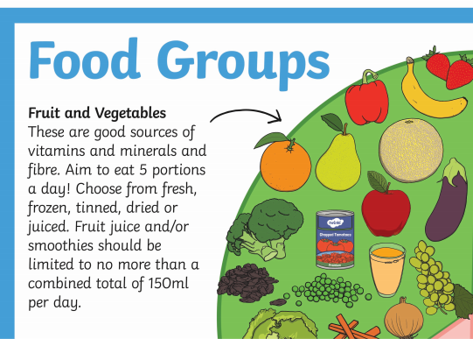
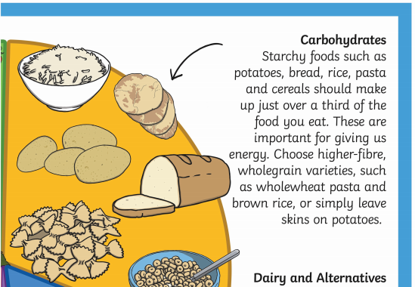
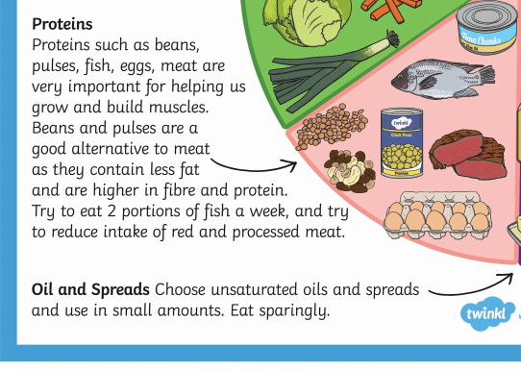
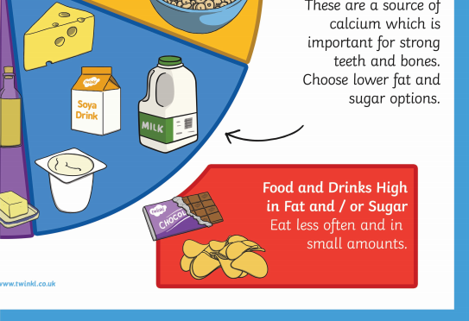
Design your own healthy plate
Notes:
Food group information

Slide 11
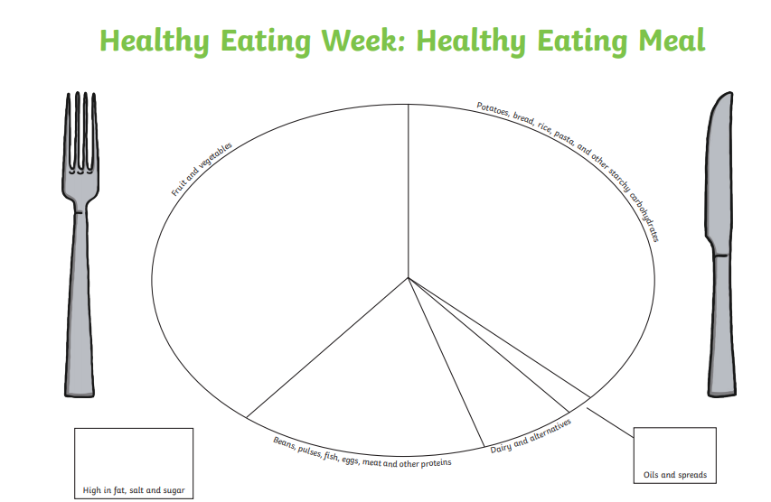
Design your own healthy plate
Notes:
Template for healthy plate

Slide 12
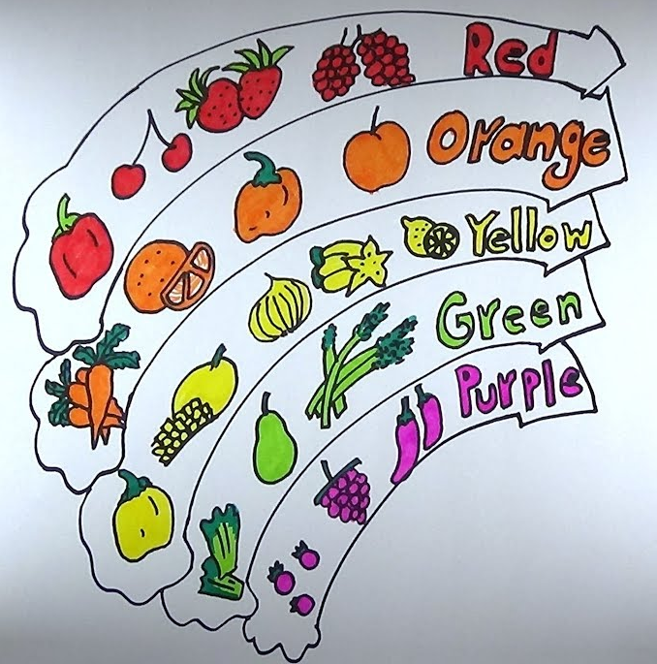
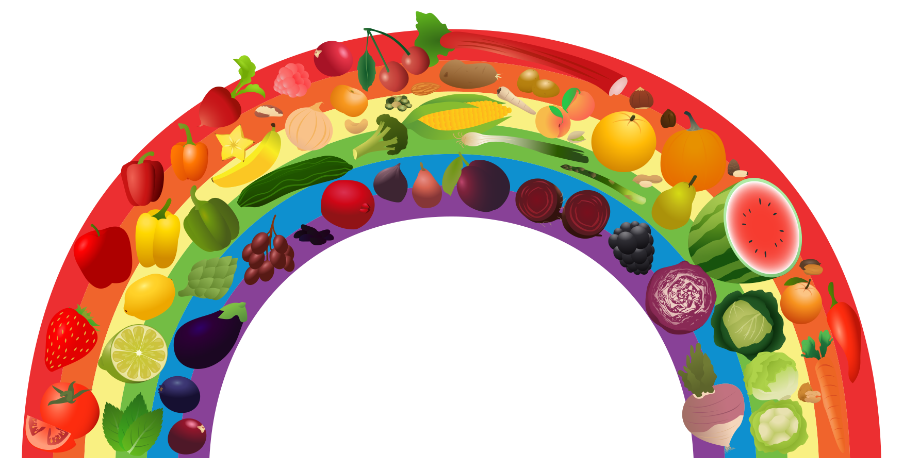
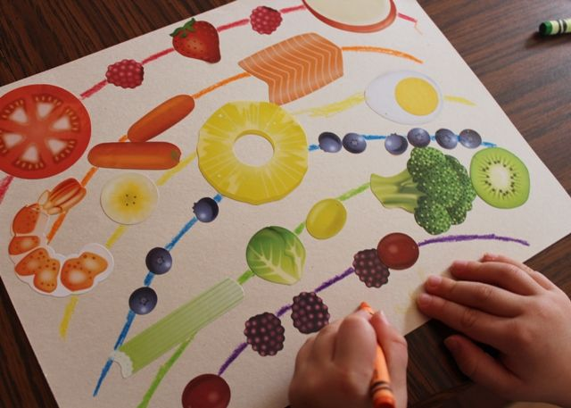
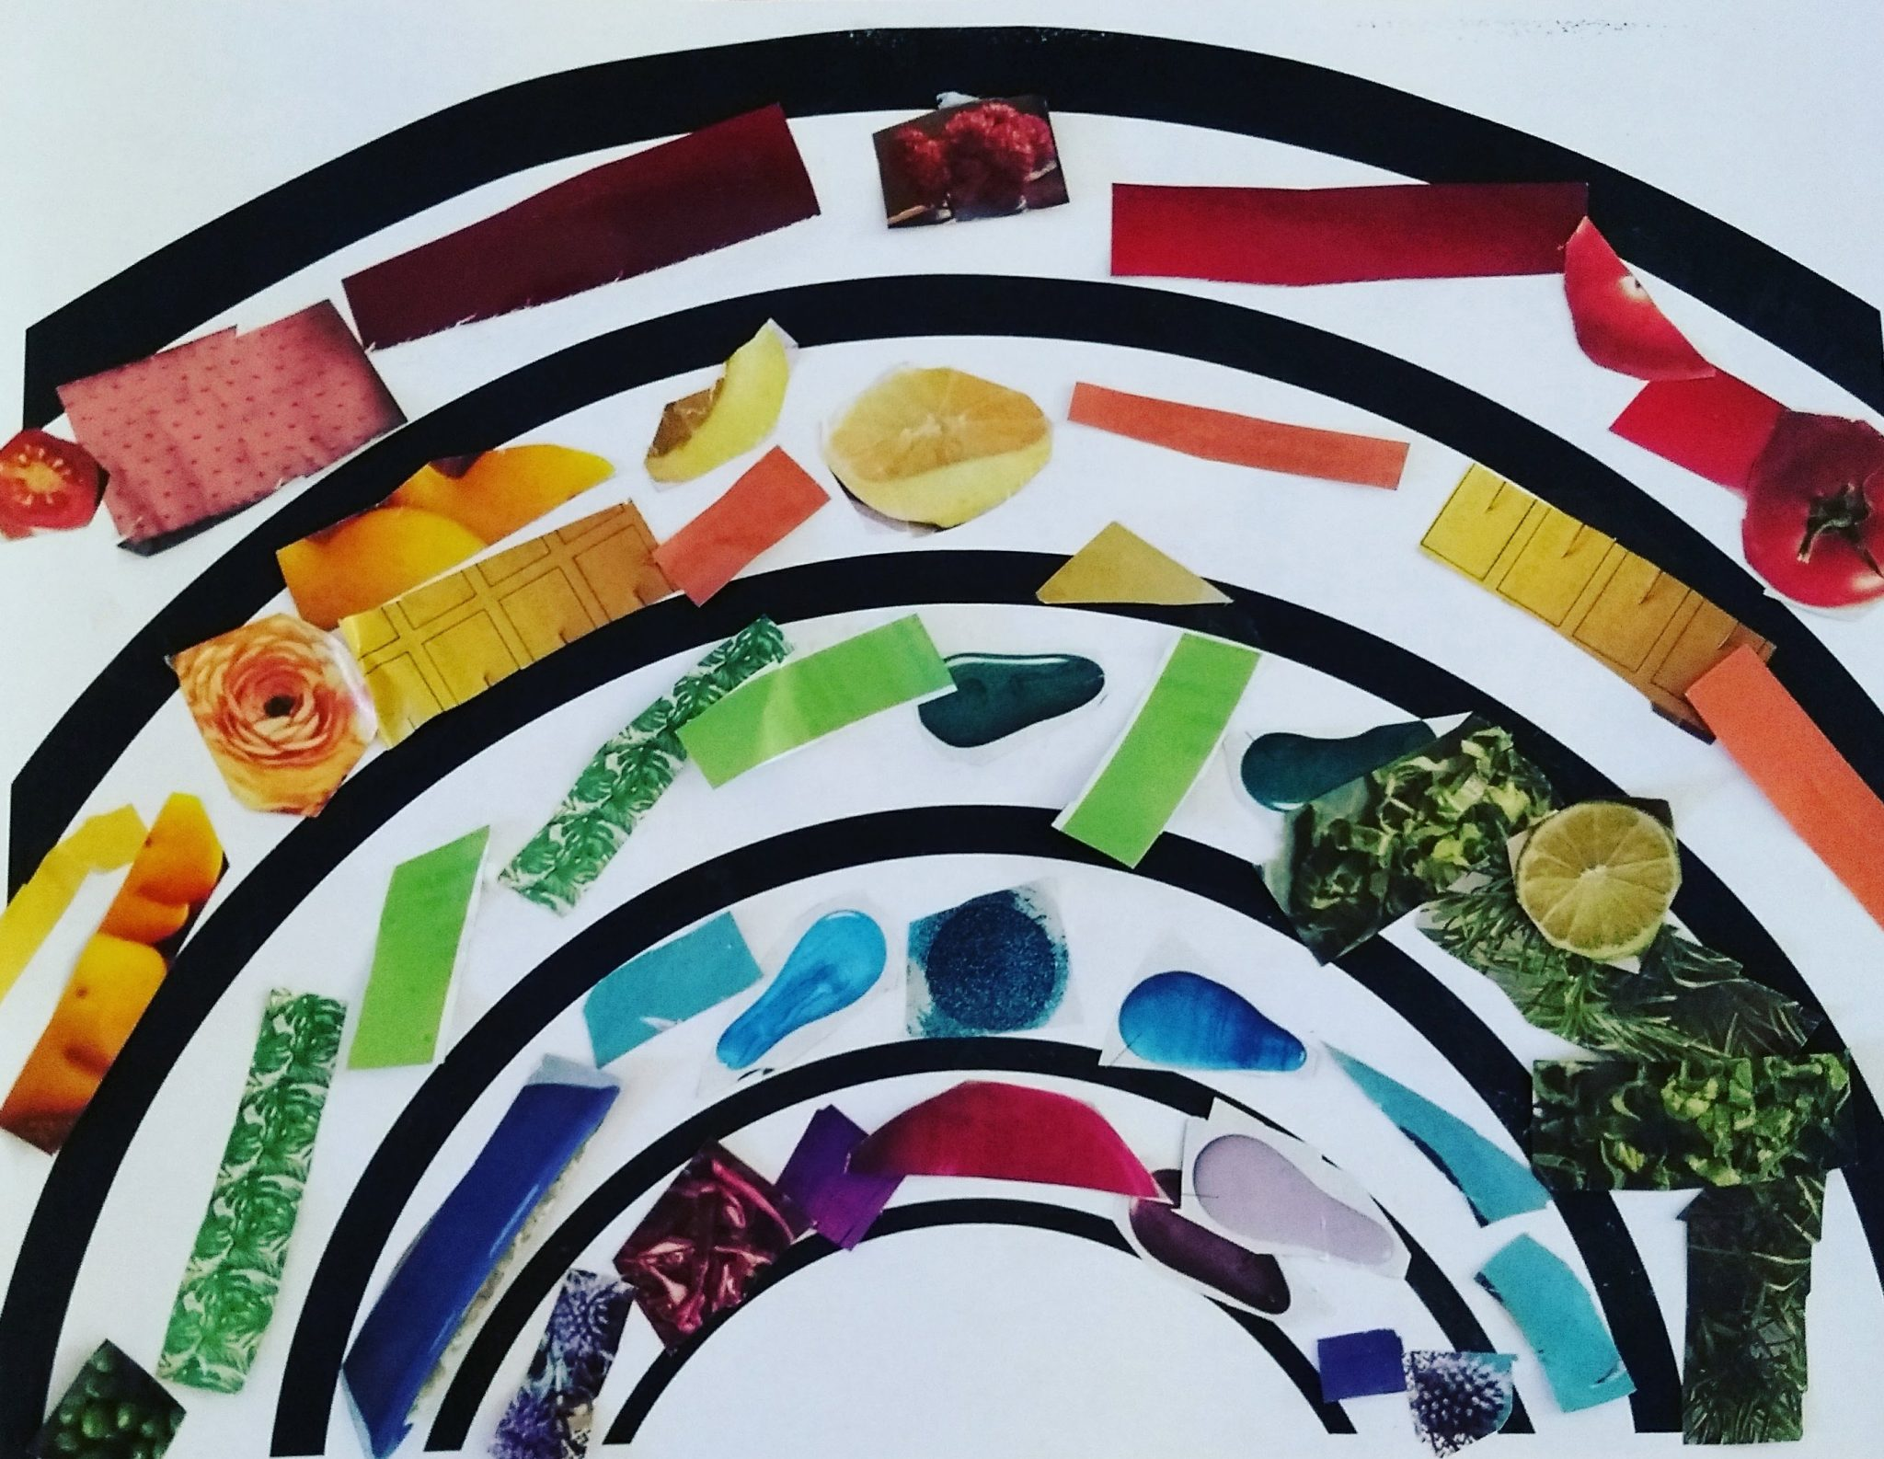
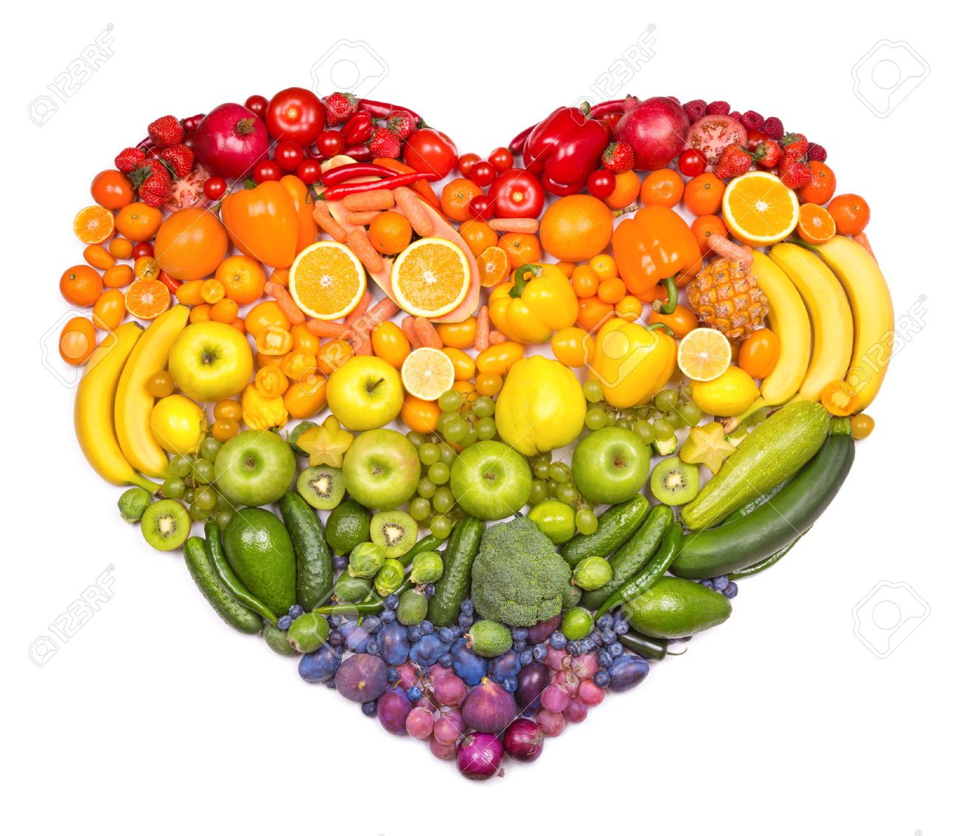

Paint, draw, make, create your own healthy food rainbow
Notes:
Ideas

Slide 13
Ready, steady, cook!
Each Year group has 2 easy to follow recipes to follow (can be changed depending on ingredients available in children’s household).
Children should follow the recipe, take photos or film a vlog of them cooking their meal. Pictures/ videos to be sent in along with any other pictures from the week so far.
Notes:
Ready, steady, cook!

Slide 14
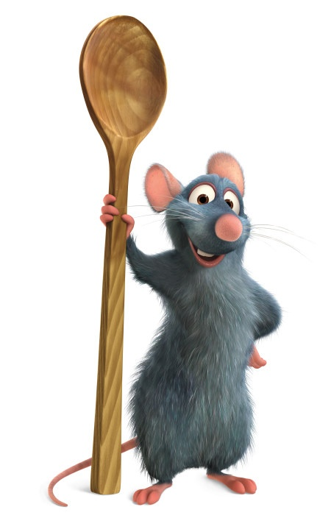
Ready, steady, cook!
Key Stage 1 and Foundation:
Picnic sandwich
https://www.bbcgoodfood.com/recipes/pressed-picnic-sandwich
Spaghetti parcel
https://www.bbcgoodfood.com/recipes/salmon-spaghetti-supper-parcel
Notes:
Links for recipes

Slide 15
Ready, steady, cook!
Year 3 and 4:
Chicken and vegetable bowl
https://www.bbcgoodfood.com/recipes/chicken-veg-bowl
Homemade pizza
https://www.bbcgoodfood.com/recipes/pizza-homemade-sauce
Notes:
Links for recipes

Slide 16
Ready, steady, cook!
Year 5:
Fajitas
https://www.bbcgoodfood.com/recipes/cooking-kids-fajitas
Stir Fry
https://www.bbcgoodfood.com/recipes/simple-stir-fry
Notes:
Links for recipes

Slide 17
Ready, steady, cook!
Year 6:
Banana Pancakes
https://www.bbcgoodfood.com/recipes/easy-banana-pancakes
Cheese and Ham Roll Ups
https://www.bbcgoodfood.com/recipes/cheese-ham-pancake-roll-ups
Notes:
Links for recipes

Slide 18

Wellness Wednesday
22nd April
Activity Ideas:
Step away from the screen and design your own board game.
Earth day pledge.
10 ways to help the Earth poster.
Notes:
Wellness Wednesday- 22nd April

Slide 19
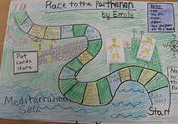
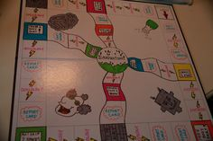
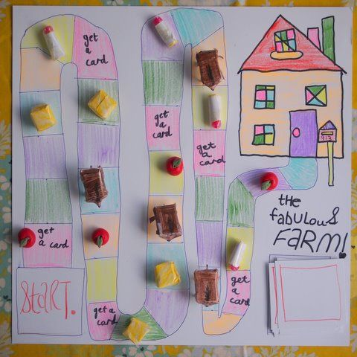
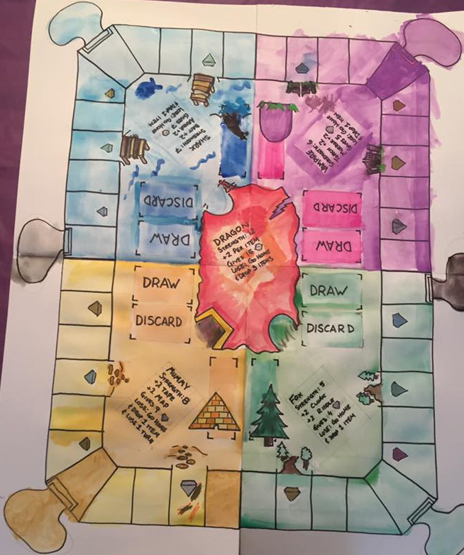
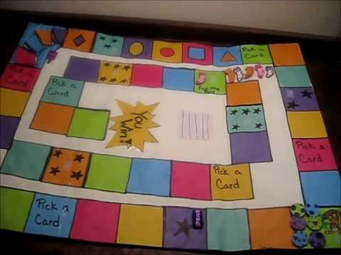
Design your own board game
Step away from your iPads, Xboxes and digital devices and create your own board game to play with your family.
Notes:
Design your own board game

Slide 20
Design your own board game
Write a set of instructions for
how to play your board game.
Notes:
Design your own board game

Slide 21
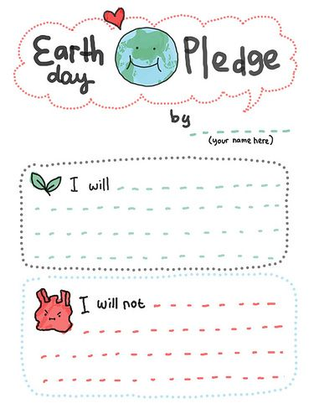
Earth day pledge
What can you do to help our Earth?
What will you not do to protect our Earth?
Notes:
Earth day pledge

Slide 22
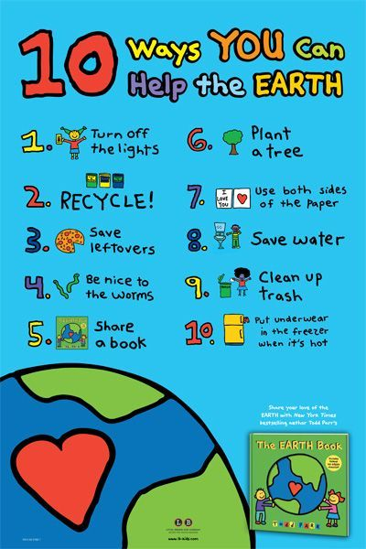
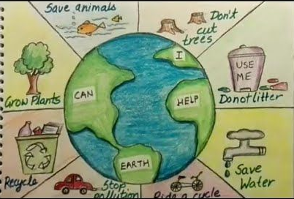
How can I help the Earth?
Create a poster listing all of the ways you can help our planet.
Notes:
Ways to help the Earth poster

Slide 23


Thoughtful Thursday
23rd April
Activity Ideas:
Write a letter to someone who you cannot see at the moment.
Kindness Bingo.
Love Lanterns.
Notes:
Thoughtful Thursday- 23rd April

Slide 24

Thoughtful Letter
Write a letter to somebody who you cannot see at the moment. It could be a Grandparent, someone in your family, a friend or your teacher. Tell them what you have been up to and try to put a smile on their face.
Notes:
Letter

Slide 25
Kindness Bingo
How many can you complete?
Help someone with a job around the house without being asked. | Make a card for someone thanking them for all they do. | Give someone a hug when the really need it. | Organise an afternoon of games for your family.
Read a book to a sibling. | Write a letter to your teacher. | Make a thank you card for a community helper. | Keep your family company on a walk.
Clean out your bedroom and donate any unwanted toys to charity. | Make “Be Happy” kindness notes and pass them out. | Make a bookmark for someone in your family. | Learn a joke and tell it to someone to make them laugh.
Call somebody in your family to say hello. | Teach someone something new. | Help make dinner. | Compliment somebody in your family.
Notes:
Kindness Bingo

Slide 26
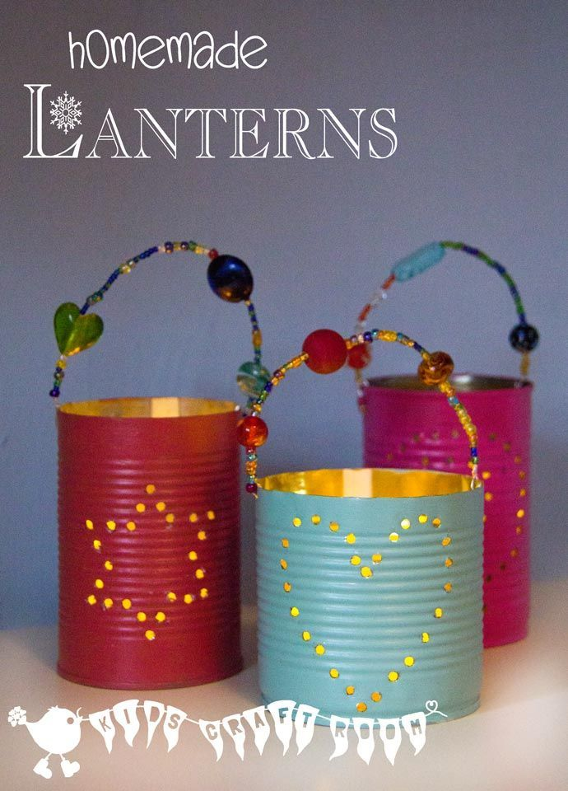
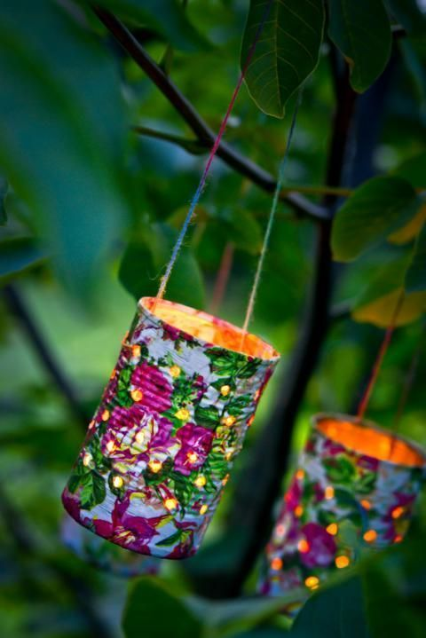
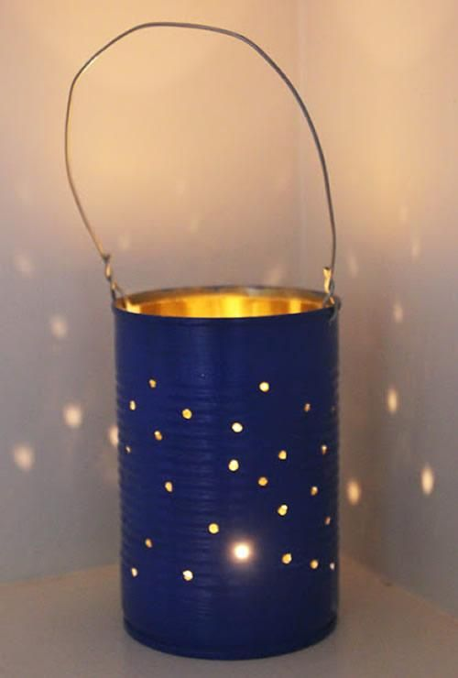
Love Lanterns
Make a love lantern for somebody you love.
Notes:
Love lanterns

Slide 27
Love Lanterns
Make a love lantern for someone you love.
All you need:
An empty can
Paint and paintbrush
String or a wire
Beads (optional)
Tea light candle
First, find an empty can and tear off the label. Make sure the can is clean on the inside.
Next, with coloured paints of your choice, paint the outside of your tin can. Add decorations, patterns and lots of colour.
After that, leave to dry for 30 minutes.
Once dry, pierce 2 holes at the top of your can (opposite one another) and thread wire or string through both sides to create a handle. If you like, add beads to your handle to decorate.
Optional: Pierce more holes on the surface of the can.
Finally, place a tea light in the middle of your can and with the help of an adult, light and watch your lantern glow.
Notes:
Love lanterns

Slide 28
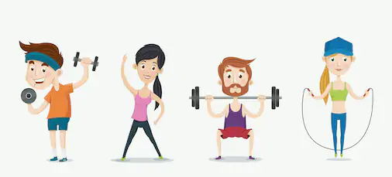
Fitness Friday
24th April
Activity Ideas:
Just Dance Challenges.
Family walk.
Create your own dance routine.
Notes:
Fitness Friday- 24th April

Slide 29

Just Dance 1- Waka Waka
Notes:
https://www.youtube.com/watch?v=gCzgc_RelBA

Slide 30

Just Dance 2- Dynamite
Notes:
https://www.youtube.com/watch?v=eughyYPoExk

Slide 31
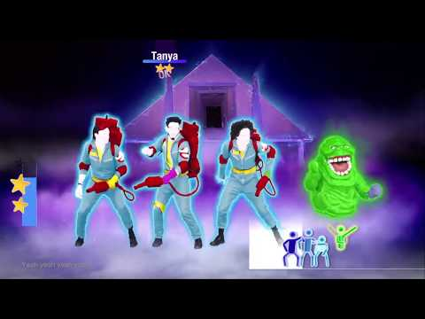
Just Dance 3- Ghost Busters
Notes:
https://www.youtube.com/watch?v=k14giRzqqUY

Slide 32
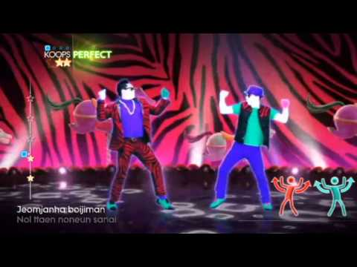
Just Dance 4- Gangnam Style
Notes:
https://www.youtube.com/watch?v=AV1biKT426I

Slide 33
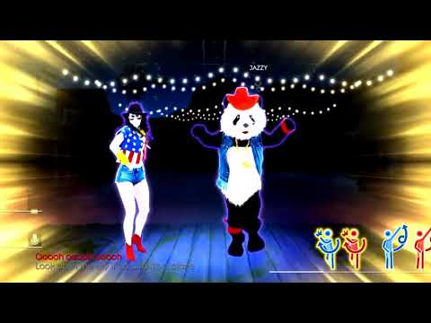
Just Dance 5- Timber
Notes:
https://www.youtube.com/watch?v=a1zQ1xOjZnk

Slide 34
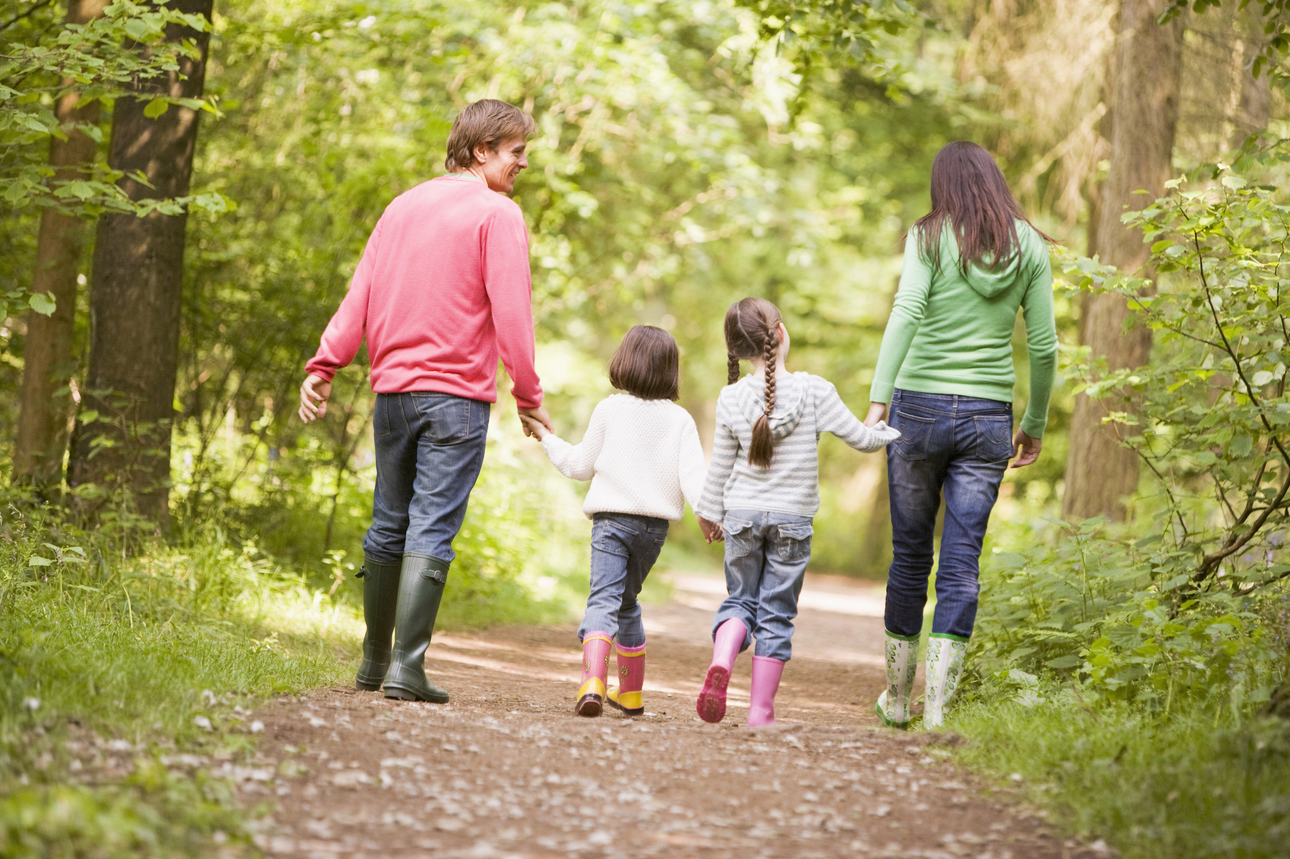
Family Walk
Why not get some fresh air and go out for a walk with members of your family?
Take some photos of what you see along the way!
Notes:
Walk

Slide 35

Dance
Make up a dance routine either by yourself or with a sibling. Perform your dance for the rest of your family and teach them the moves.
Notes:
Dance

